Slide 1
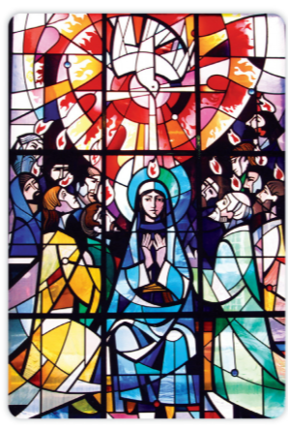
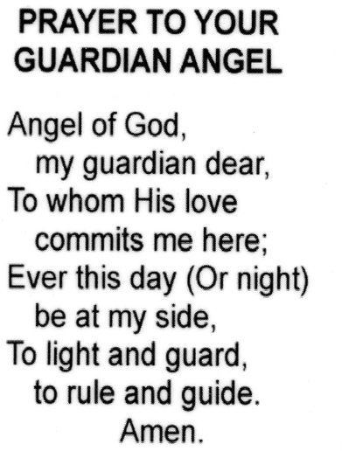
Catholic social Teaching
Solidarity
Community
Social Justice
Dignity
Religious Education
To the Ends of The Earth
Summer 1
Knowledge Organiser
Year 3
Scripture
The road to Emmaus Luke 24. 13-35
The mission to the world Matthew 28. 16-20
The group of apostles and Mary Acts 1. 12-14
The early Church Acts 2. 42-47
Paul’s letter to the Corinthians 1 Cor 11. 23-27
Key Vocabulary
Emmaus
Holy Spirit
Pentecost
Concluding rite
St. Paul
Discipleship
Key Question
How do we know the early Christian communities had received the Holy Spirit? Where do we see the Holy Spirit in our lives?
Feast Days
St George 23rd April
St Mark 25th April
St Catherine of Sienna 29th April
The Ascension 14th May

Slide 2
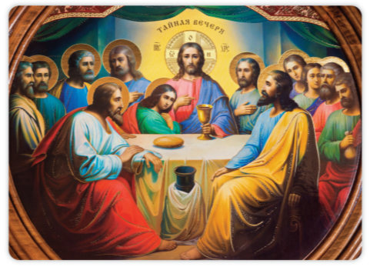
Catholic social Teaching
Solidarity
Option for the poor
Care for the vulnerable
Community
Religious Education
Dialogue and Encounter
Summer 2
Knowledge Organiser
Year 3
Scripture
Passover Exodus 12. 1-8, 15-20, 13.3
Institution of the Eucharist Luke 22. 14-23
Key Vocabulary
Passover
Unleavened
Exodus
Muslim
Islam
Ramadan
Sawm
Adhan
Feast Days
Pentecost 24th May
The most Holy Trinity 31st May
The body and Blood of Christ 7th June
Sacred Heart of Jesus 12th June
St Peter and St. Paul 28th June
St Thomas 3rd July
Key Question
What is the meaning of the Exodus? How is the Exodus linked to the Last Supper?

